Slide 1

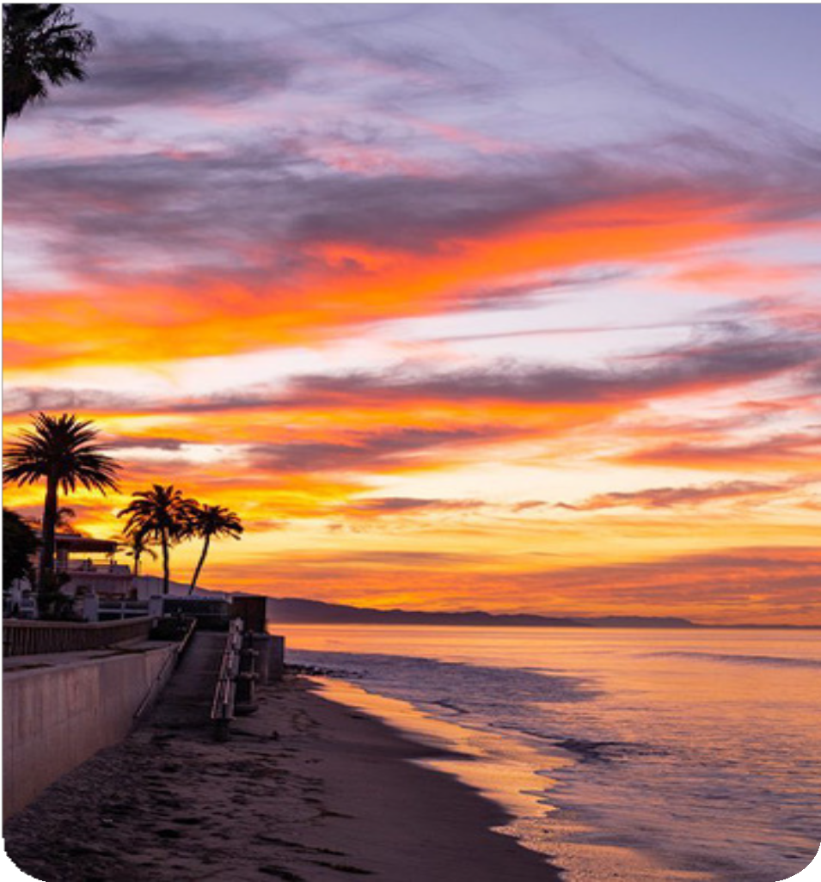
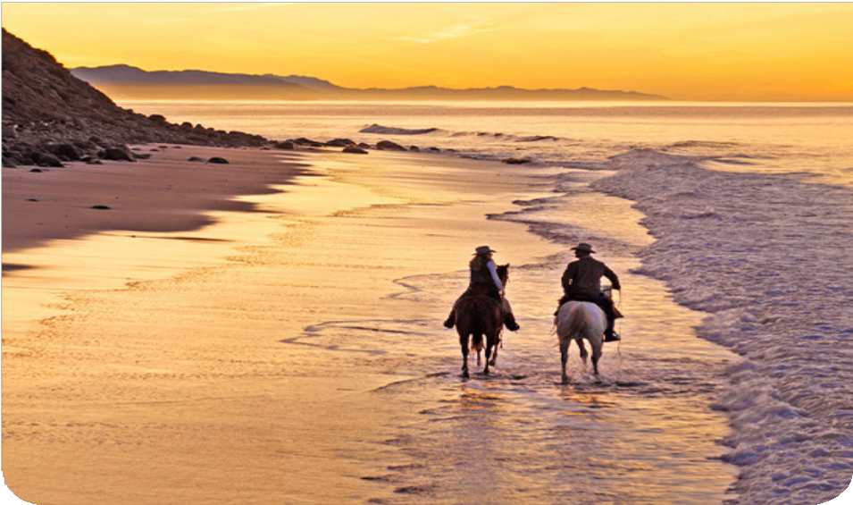

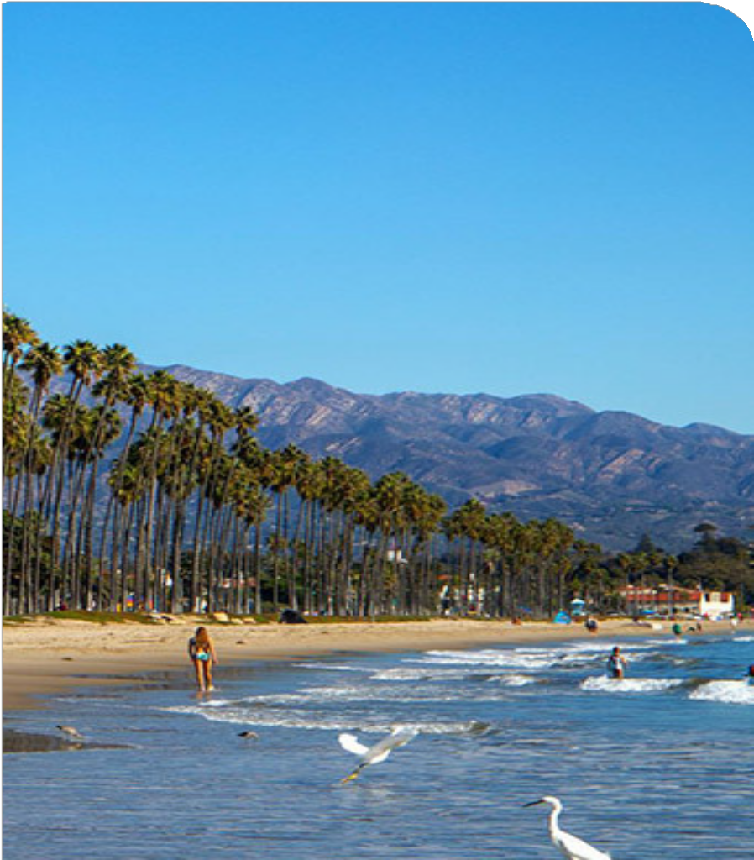
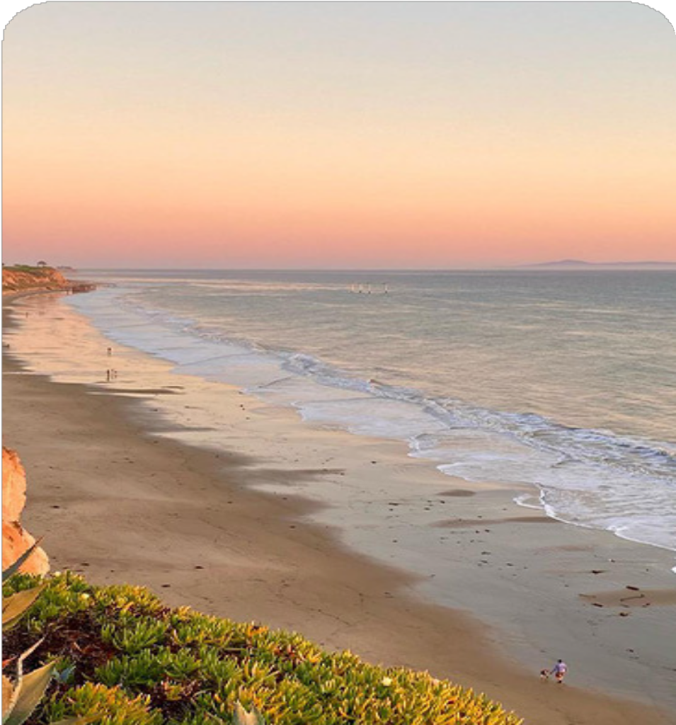
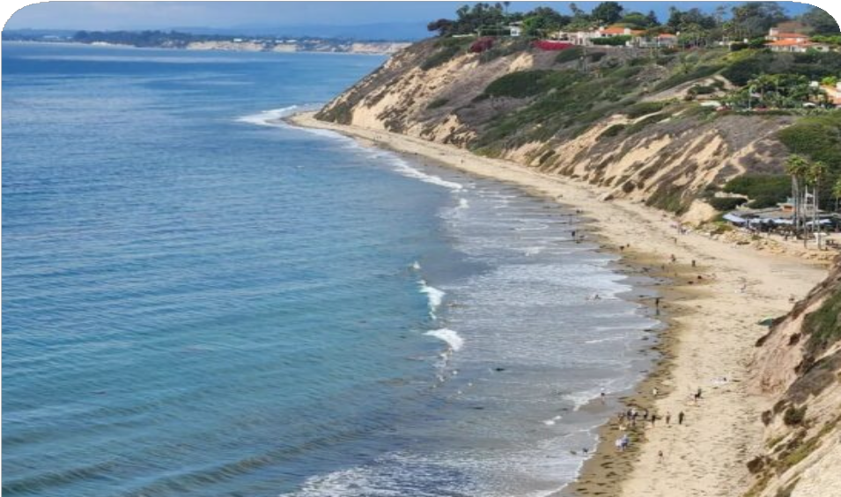
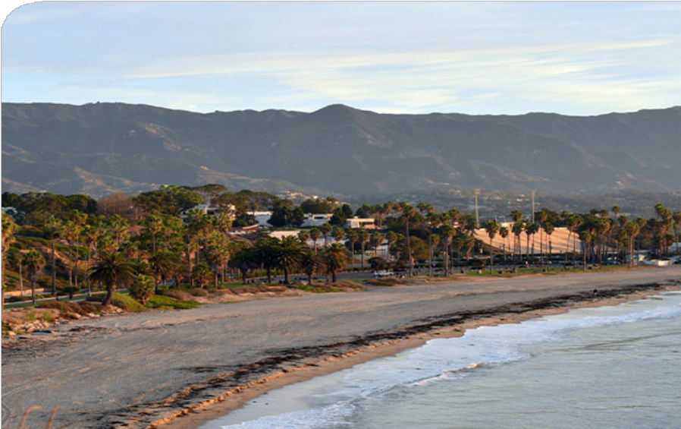
Operations and Oversight of Santa Ynez Unit
California Natural Resources Agency (CNRA)
Presentation
March 13, 2025

Slide 2
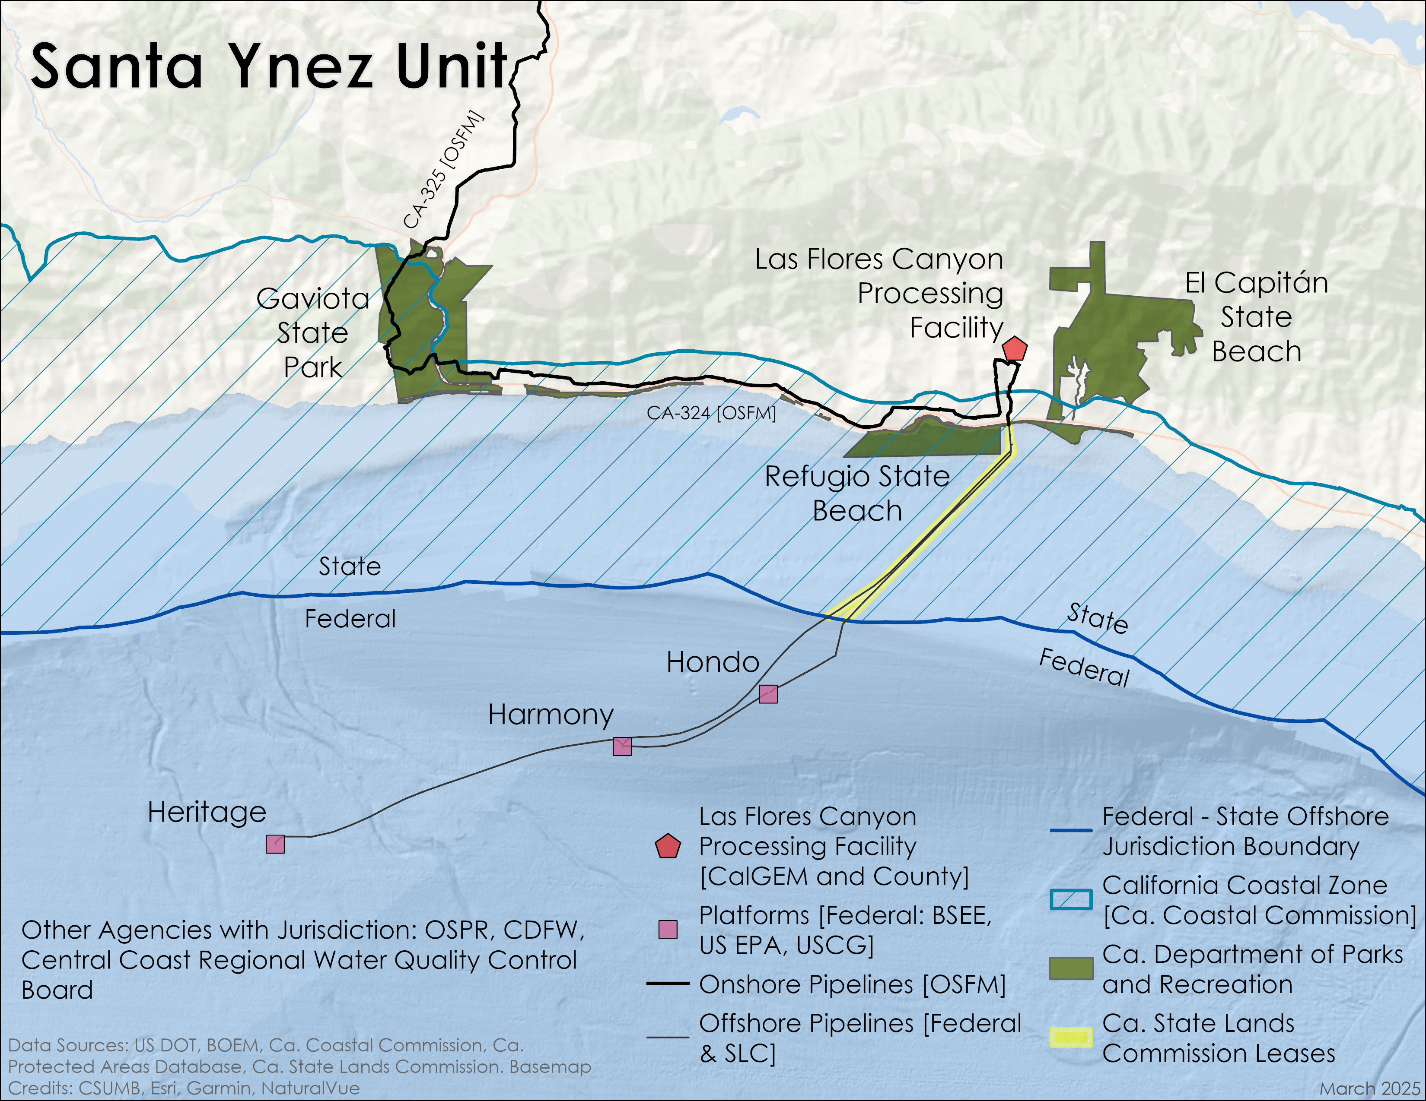
Santa Ynez Unit

Slide 3
Overview
8 state agencies oversee different parts of the Santa Ynez Unit operations and have different authorities over these components.
Each of the 8 state agencies is focused on protecting public health, safety and the environment.
Owner-operators of the oil pipelines (CA-324 and CA-325) within the Santa Ynez Unit must meet specific state laws and rules before any restart of operations.

Slide 4
State Regulatory Agencies
California Coastal Commission
State Lands Commission
California Department of Fish and Wildlife (CDFW)
  Office of Oil Spill Prevention and Response (OSPR)
California Department of Forestry and Fire Protection (CAL FIRE)
  Office of the State Fire Marshal (OSFM)
California Department of Conservation
  California Geologic Energy Management Division (CalGEM)
California Department of Parks and Recreation (State Parks)
Central Coast Regional Water Quality Control Board
Central Valley Regional Water Quality Control Board

Slide 5
Purpose of Today’s Meeting
Explain roles and responsibilities of the 8 state agencies with oversight of the Santa Ynez Unit.
Share recent, current, and planned actions of these state agencies.
Highlight opportunities for public engagement and participation.

Slide 6
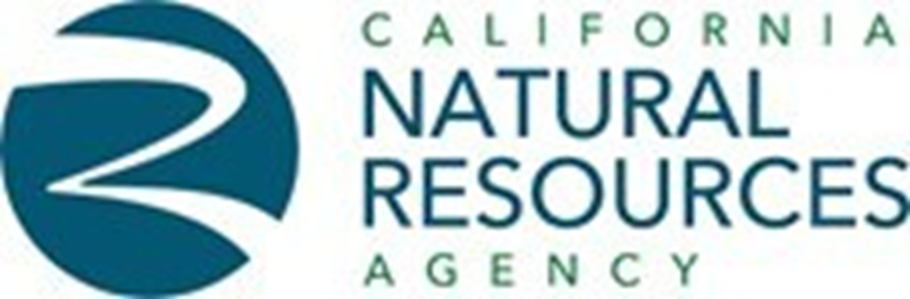
www.resources.ca.gov

