Slide 1
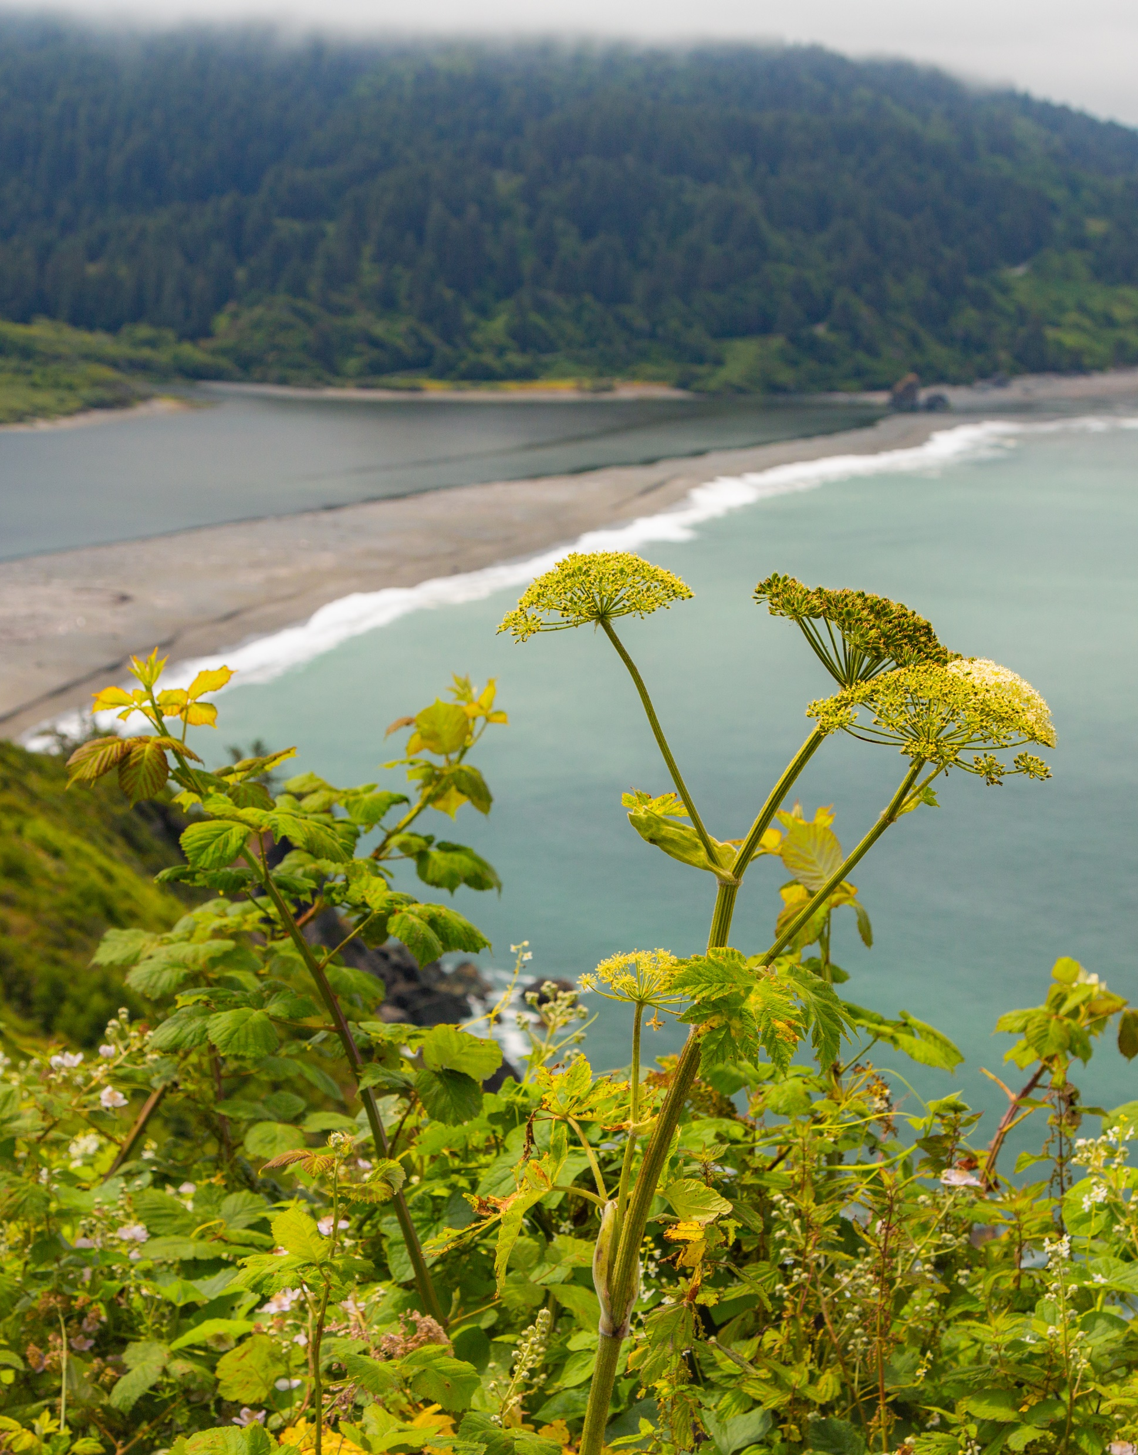

The California Department of Fish and Wildlife
(CDFW)
Presented by:
Charlton “Chuck” Bonham
Director, California Department of Fish and Wildlife

Slide 2
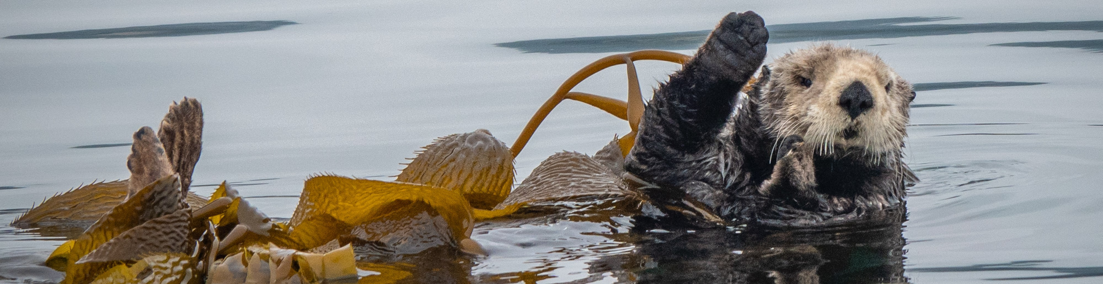
About CDFW
CDFW’s mission is “to manage California's diverse fish, wildlife, and plant resources, and the habitats upon which they depend, for their ecological values and for their use and enjoyment by the public.”
CDFW serves as the trustee for the State’s fish and wildlife resources for the conservation, protection, and management of fish, wildlife, native plants, and habitat necessary for sustainable populations of those species.
CDFW also owns and manages lands statewide to support species and habitats and for the enjoyment of the public.
Document Accessibility Tips: Title placeholder boxes found across this template have “Missing Slide Title” errors that are resolved once populated with custom text. Likewise, picture placeholder boxes have “Missing Object Description” errors that are resolved once populated with alt text. Exporting to a PDF? Be aware that accessibility errors may occur once the template has been customized.
As always, please conduct an accessibility check and remediate as needed before finalizing/publishing.

Slide 3
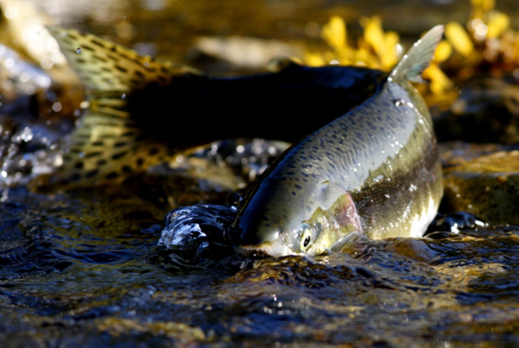
CDFW’s Role
In addition to its trustee role, CDFW has a regulatory role:
  Lake and Streambed Alteration Agreements: required when a project may alter or impact a river, stream or lake
  California Endangered Species Act: protects endangered or threatened species

Slide 4
CDFW’s Role Cont.
CDFW encourages projects to minimize harm to fish, wildlife and habitats as much as possible.
  When impacts cannot be avoided, authorizations will include measures to minimize impacts to fish and wildlife resources and measures to mitigate for any impacts that cannot be avoided.
  Other provisions in the Fish and Game Code include prohibitions to protect fish and wildlife resources, such as prohibiting persons from depositing into state waters substances harmful to fish and wildlife resources.
Document Accessibility Tips: Title placeholder boxes found across this template have “Missing Slide Title” errors that are resolved once populated with custom text. Likewise, picture placeholder boxes have “Missing Object Description” errors that are resolved once populated with alt text. Exporting to a PDF? Be aware that accessibility errors may occur once the template has been customized.
As always, please conduct an accessibility check and remediate as needed before finalizing/publishing.

Slide 5
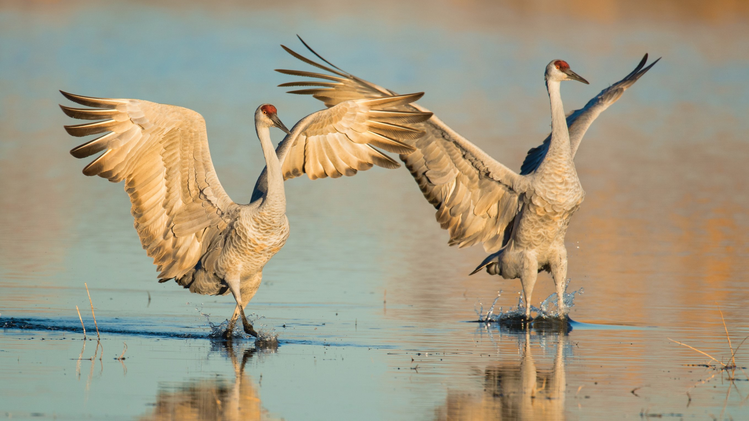
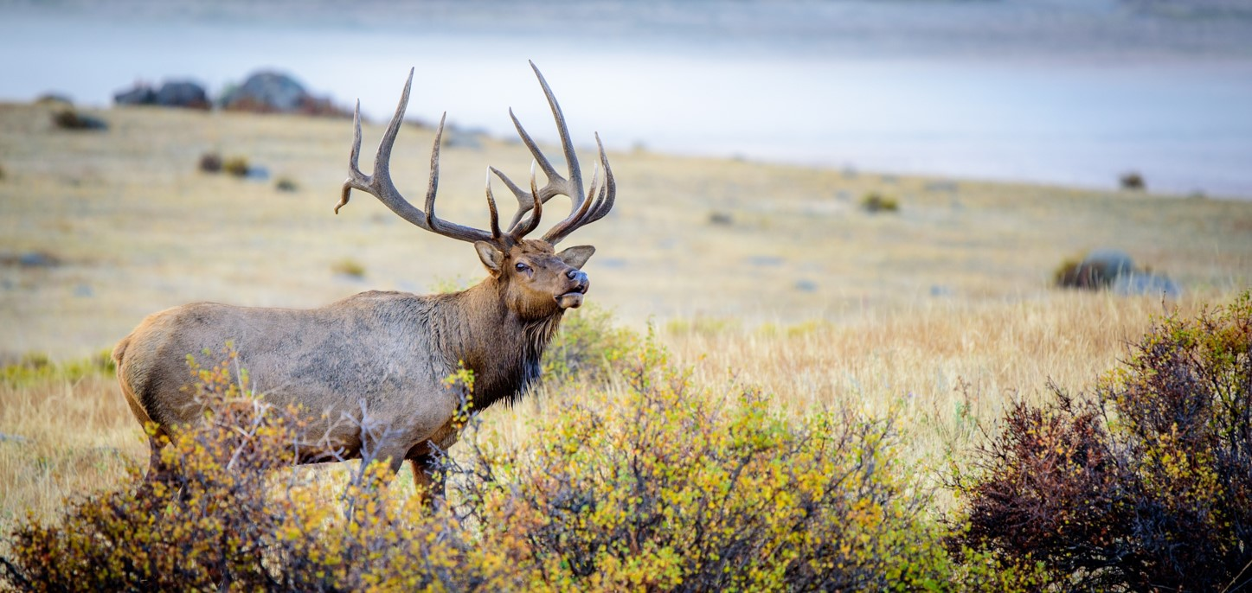
Recent Timeline of Events
October 2024: CDFW letter to Sable recommending it determine if permits would be needed
November 2024: CDFW learned of work in or near a streams, or on CDFW’s lands; notice sent to Sable
December 17, 2024: Notice of Potential Violation
December to present: CDFW is reviewing Sable’s response and subsequent notifications

