Slide 1
Welcome to the Climate-Safe Infrastructure Webinar Series
Supporting AB2800 and the Work of California’s Climate-Safe Infrastructure Working Group
April 10, 2018 | 12-1pm

Slide 2
Hosts
Juliette Finzi Hart | USGS
Co-Facilitator of CSIWG’s work
Email: jfinzihart@usgs.gov
Susi Moser | Susanne Moser Research & Consulting
Co-Facilitator of CSIWG’s work
Email: promundi@susannemoser.com

Slide 3
AB 2800 (Quirk): Purpose
Examine how to integrate scientific data concerning projected climate change impacts into state infrastructure engineering, including oversight, investment, design, and construction.
Project Decision Making
Climate Change Impacts Science
Engineering Standards, Project Planning and Design
Project Construction Maintenance and Monitoring

Slide 4
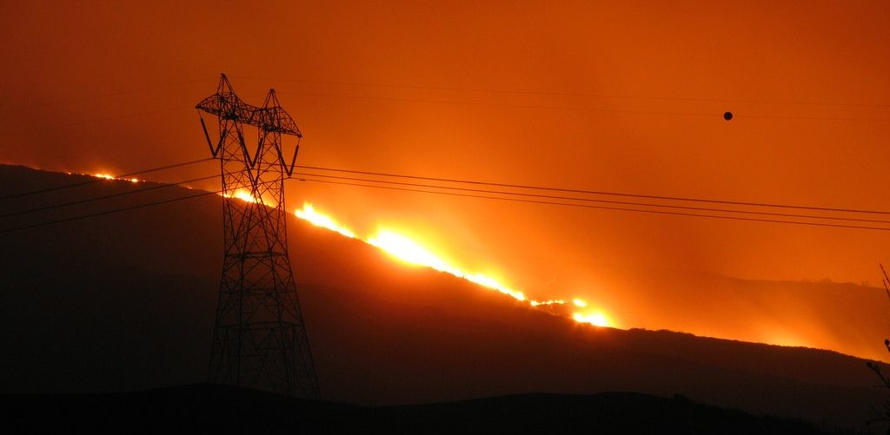
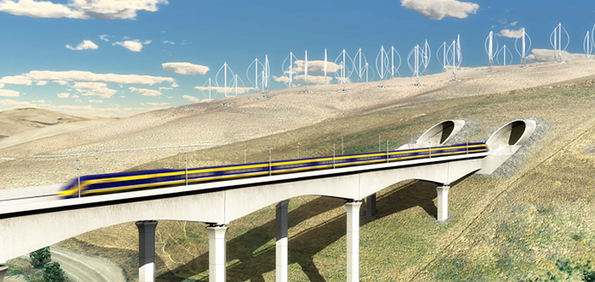
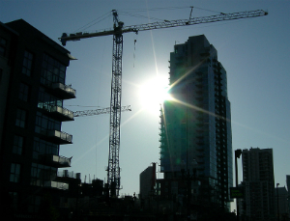
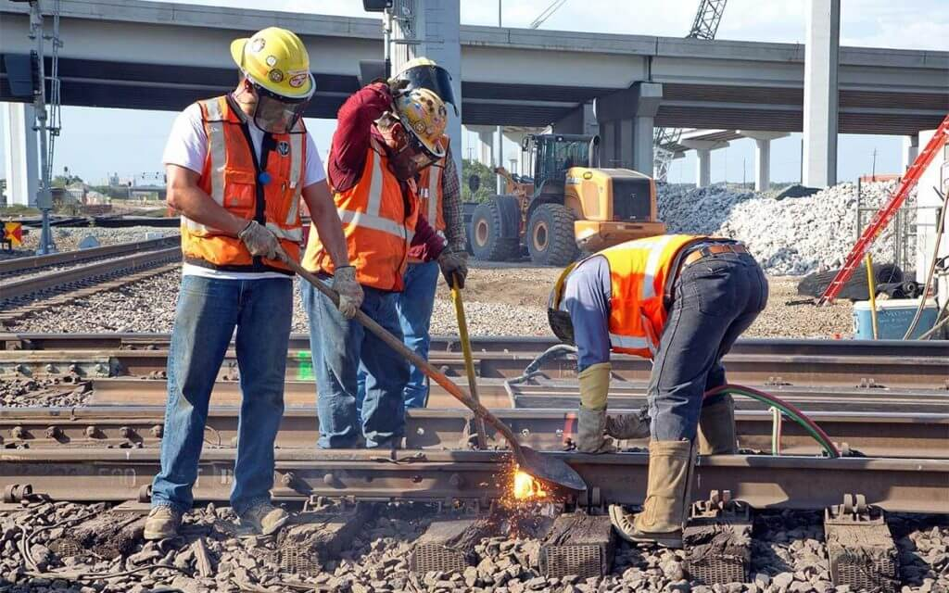
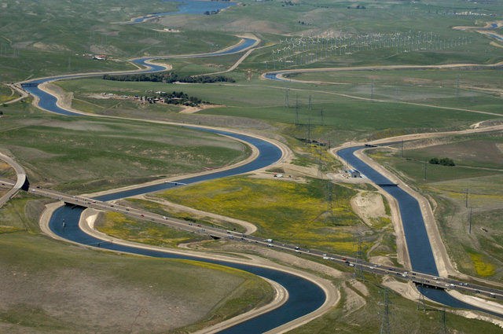
AB 2800 (Quirk): Scope of Assessment and Recommendations
The working group shall consider and investigate, at a minimum, the following issues:
(1) informational and institutional barriers to integrating climate change into infrastructure design.
(2) critical information needs of engineers.
(3) selection of appropriate engineering designs for different climate scenarios.

Slide 5
The Climate-Safe Infrastructure Webinar Series
Purpose
Hear from others elsewhere with relevant experience and expertise.
Hear from CSIWG members.
Educate and engage with interested stakeholders on climate change and infrastructure issues.
Sample of Webinar Topics
What climate science can offer
Various sectoral perspectives
Processes of changing engineering standards and guidelines
Holistic infrastructure planning and management
Financing climate-safe infrastructure
And others…
Notes:
Purpose of the CSI webinar series
Bring in outside expertise and perspectives to enrich CSIWG discussions.
Provide opportunity for CSIWG members to share their expertise.
Educate and engage with interested stakeholders on climate change and infrastructure issues.

Slide 6
A Couple of Housekeeping Items
Please type your questions for presenters into the chat box
We will try to answer as many as possible after the presentations
Answers to remaining questions will be posted on the website

Slide 7
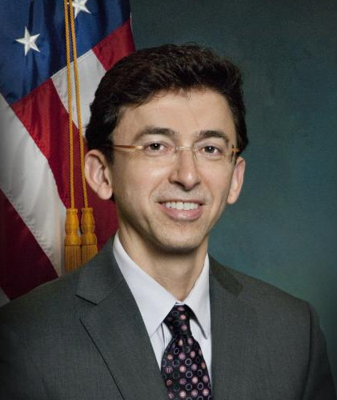
Governing Infrastructure:
How Regulations, Standards, Codes and Guidelines
Are Set and Changed
J. Alfredo Gomez
US Government Accountability
Office
Stephen A. Cauffman
National Institute of Standards
and Technology
Ira Feldman
GHGMI Adaptation Leader
Adaptation Coordinator, ISO
President & Senior Counsel,
Greentrack Strategies
Founder, Climate Adaptation Scholars™

Slide 8
Climate Change and Infrastructure
Overview of GAO’s Recent Work
Presentation to the Climate-Safe Infrastructure Working Group
April 10, 2018
Alfredo Gomez
Director, Natural Resources and Environment
U.S. Government Accountability Office

Slide 9
About GAO
The U.S. Government Accountability Office (GAO) is an independent, nonpartisan agency that works for the U.S. Congress—our government’s legislative branch.
Often called the “congressional watchdog,” GAO investigated how the federal government spends taxpayer dollars.
GAO’s work is done at the request of congressional committees or subcommittees or is mandated by public laws or committee reports. GAO also undertakes research under the authority of the Comptroller General.

Slide 10
GAO’s Natural Resources and Environment Team
The Natural Resources and Environment (NRE) team is responsible for GAO’s assessments of federal efforts to:
Manage the nation’s land and water resources.
Protect the environment.
Ensure food safety.
Manage agricultural programs.
Ensure a reliable and environmentally sound energy supply.
Meet the nation’s science challenges.
Address U.S. and international nuclear security and cleanup.

Slide 11
GAO’s High-Risk Series
In 2013 (GAO-13-283), we added Limiting the Federal Government’s Fiscal Exposure by Better Managing Climate Change Risks to our list of areas at high risk for fraud, waste, abuse, and mismanagement, or most in need of transformation.
In our 2017 update (GAO-17-317), we reported that the federal government needs a cohesive strategic approach with strong leadership and the authority to manage climate change risks.
Notes:
Every 2 years at the start of a new Congress, GAO calls attention to agencies and program areas that are high risk.
Climate change is a crosscutting issue, affecting almost all the issue areas in NRE and other teams across GAO.

Slide 12
Climate Change Increases the Fiscal Exposure of the Federal Government in 5 areas
Infrastructure: Owns or operates extensive infrastructure vulnerable to climate impacts, such as defense facilities and federal property.
Insurance: Insures property and crops vulnerable to climate effects.
Technical Assistance: Provides data and technical assistance to federal, state, local, and private-sector decision makers responsible for managing the impacts of climate change on their activities.
Disaster Assistance: Provides disaster relief aid.
Strategic Planning: Federal government is not well organized to address its fiscal exposures, partly because of the cross-cutting nature of the issue.
One way to reduce the potential impacts of climate change is to enhance climate resilience
Notes:
GAO has ongoing and completed work in each of these categories, for example:
Strategic Plan: Climate Change: Improvements Needed to Clarify National Priorities and Better Align Them with Federal Funding Decisions, GAO-11-317.
Federal Property and Resources: Climate Change Adaptation: DOD Can Improve Infrastructure Planning and Processes to Better Account for Potential Impacts, GAO-14-446.
Federal Flood and Crop Insurance Programs: Flood Insurance: Comprehensive Reform Could Improve Solvency and Increase Resilience, GAO-17-425.
Technical Assistance: Climate Information: A National System Could Help Federal, State, Local, and Private Sector Decision Makers Use Climate Information, GAO-16-37.
Disaster Aid: Hurricane Sandy: An Investment Strategy Could Help the Federal Government Enhance National Resilience for Future Disasters, GAO-15-515 .

Slide 13
Recent GAO Work on Climate Information
In 2015 (GAO-16-37), we issued a report on climate information needs and examined the use of climate information systems in other countries.
We recommended that the executive branch (1) develop a set of authoritative climate change projections and observations and (2) create a national climate information system with defined roles for federal agencies and nonfederal entities.
Notes:
Key Findings:
We found that the climate information needs of federal, state, local, and private sector decision makers are not being fully met.
Other nations (Germany, the Netherlands, and the United Kingdom) had well-established climate information systems.
Federal climate information efforts could be improved by incorporating key organizational and data elements.
Options to provide climate information and technical assistance to decision makers have strengths and limitation.
as of June 2017, the EOP has not implemented our recommendations.

Slide 14
Recent GAO Work on Climate Change and Infrastructure
In 2016 (GAO-17-3), we recommended that the National Institute of Standards and Technology (NIST) convene an ongoing governmentwide effort to provide forward-looking climate information to standards organizations.
In 2013 (GAO-13-242), we recommended that an entity designated by the Executive Office of the President should work with relevant agencies to identify the “best available” climate-related information, among other things.
Notes:
Key Findings for GAO-17-3:
Selected standards-developing organizations generally have not used forward-looking climate information—such as projected rainfall rates—in design standards, building codes, and voluntary certifications and instead have relied on historical observations.
Standards-developing organizations face institutional and technical challenges to using the best available forward-looking climate information.
Agencies have initiated some actions and could take more to help standards-developing organizations address challenges.
As of October 2017, NIST has not implemented our recommendation.
Key Findings for GAO-13-242:
Infrastructure such as roads and bridges, wastewater systems, and NASA centers are vulnerable to changes in the climate.
Decision makers have not systematically considered climate change in infrastructure planning for various reasons.
Key factors enabled some local decision makers to integrate climate change into infrastructure planning, including (1) having local circumstances such as weather-related crises that spurred action, (2) learning how to use available information, (3) having access to local expertise, and (4) considering climate impacts within existing planning processes.
Several emerging federal efforts are under way to facilitate more informed adaptation decisions, but these efforts could better support the needs of local infrastructure decision makers in the future.
As of June 2017, this recommendation and two others have not been implemented.

Slide 15
Recent GAO Work on Climate Change and Military Installations
In March 2018, Congress directed GAO to evaluate the Department of Defense’s (DOD) progress in accounting for potentially damaging weather in infrastructure project design.
In 2017 (GAO-18-206), we found that military services have integrated climate change adaptation into installations' plans and project designs to a limited extent.
In 2014 (GAO-14-446), we found that DOD has begun to assess installations’ vulnerability to potential climate change impacts and directed its planners to incorporate consideration of climate change into certain installation planning efforts.
Notes:
This mandate was in P.L 115-141 Consolidated Appropriations Act, 2018. S. Rpt. 115-130 To Accompany S. 1557 Military Construction, Veterans Affairs, and Related Agencies Appropriations Act, 2018. Title I. Military Construction. DCM will be the programming team.
In GAO-18-206, we recommended that DOD (1) require its oversea installations to track costs associated with extreme weather and climate change, (2) administer its vulnerability assessment to all relevant locations, and (3) incorporate climate change adaptation into guidance for developing installation plans, including master plans and natural resource plans, at all locations.
In GAO-14-446, we recommended that DOD (1) develop plans and milestones that describe how it intends to use the data collected through the assessment in support of climate change adaptation planning; (2) clarify the planning actions that should be taken to account for climate change in installation Master Plans and Integrated Natural Resource Management Plans; (3) clarify instructions so that climate change adaptation is considered as a project component that may be needed to address potential climate change impacts on infrastructure.

Slide 16
Climate Change and Infrastructure
Questions?

Slide 17
GAO on the Web
Connect with GAO on LinkedIn, Facebook, Flickr, Twitter, YouTube and our Web site: https://www.gao.gov/
Subscribe to our RSS Feeds or E-mail Updates. Listen to our Podcasts and read The Watchblog
Congressional Relations
Orice Williams Brown, Managing Director, WilliamsO@gao.gov
(202) 512-4400, U.S. Government Accountability Office 441 G Street, NW, Room 7125, Washington, DC 20548
Public Affairs
Chuck Young, Managing Director, youngc1@gao.gov (202) 512-4800, U.S. Government Accountability Office 441 G Street, NW, Room 7149, Washington, DC 20548
Strategic Planning and External Liaison
James-Christian Blockwood, Managing Director, spel@gao.gov (202) 512-4707, U.S. Government Accountability Office, 441 G Street NW, Room 7814, Washington, DC 20548
Copyright
This is a work of the U.S. government and is not subject to copyright protection in the United States. The published product may be reproduced and distributed in its entirety without further permission from GAO. However, because this work may contain copyrighted images or other material, permission from the copyright holder may be necessary if you wish to reproduce this material separately.

Slide 18
NIST Community Resilience Guides
AB2800 Governance Webinar
April 10, 2018
Stephen A. Cauffman
Engineering Laboratory
National Institute of Standards and Technology

Slide 19
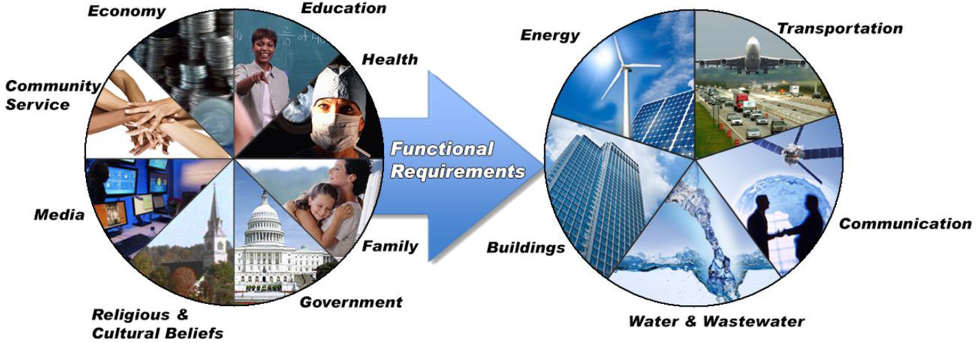
Community Resilience
Communities are socio-technical systems with various stressors
Buildings and infrastructure enable social and economic function
Social and economic needs and functions should inform the goals for performance of buildings and physical infrastructure
All communities are exposed to hazards that can cause disruption to social and economic activity
Resilient communities recognize and mitigate the consequences of hazard events on their buildings and physical infrastructure
Notes:
Changed title to a statement since they have answered the why question and we need to now define the aspects of community resilience we will be working with
Added reference to stressors to the first bullet. That needs to be recognized and put into perspective right at the start
Bullet 3, changed drive to inform to signal that those needs set the goals and subsequently setting the priorities for addressing the gaps that are discovered
Also changes the graphics to Liesel’s. We need to introduce all the terms since they will be a part of what follows.
Added a 5th bullet to define community resilience related to this effort

Slide 20
Challenges
What hazards should the community be resilient to?
How to define the interconnected nature of social systems, buildings, and infrastructure?
How to identify performance gaps (“measure”) resilience?
Hazards
Natural hazards
Technological hazards
Human-caused hazards
Degradation
Hazard Level
Routine
Expected
Extreme
Notes:
First Bullet Added “hazards” to focus on this effort
Second bullet Changed “account for ” to “define the ” since we are gong to be defining the interconnection

Slide 21
Goals of Resilience Planning
Prepare for and adapt to changing conditions and withstand and recover quickly from disruptions.
Ensure that community is on a sustainable path that meets the needs of residents and businesses.
Provide for the safety and security of businesses and residents given the expected hazards.
Integrate planning through a lens of resilience to create a sustainable and viable future for the community.
Place community on a path to building resilience through normal processes of development, maintenance, operation, renovation, repair, and replacement of buildings and infrastructure.

Slide 22
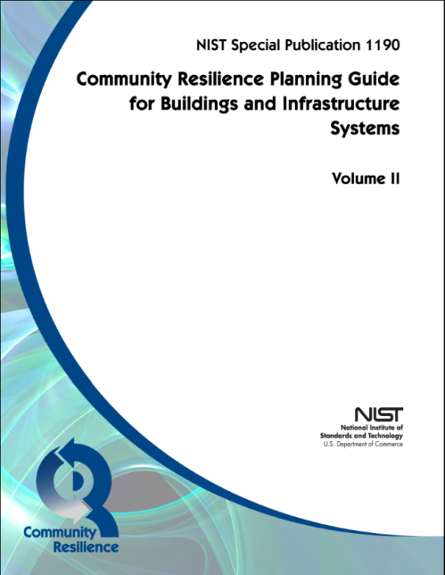
Planning Guide Outline
Volume 1 - Methodology
Volume 2 - Reference
Executive Summary
Introduction
6 Step Methodology
Planning Example – Riverbend
Glossary and Acronyms
Executive Summary
Social Community
Dependencies and Cascading Effects
Buildings
Transportation Systems
Energy Systems
Communications Systems
Water & Wastewater Systems
Community Resilience Metrics

Slide 23
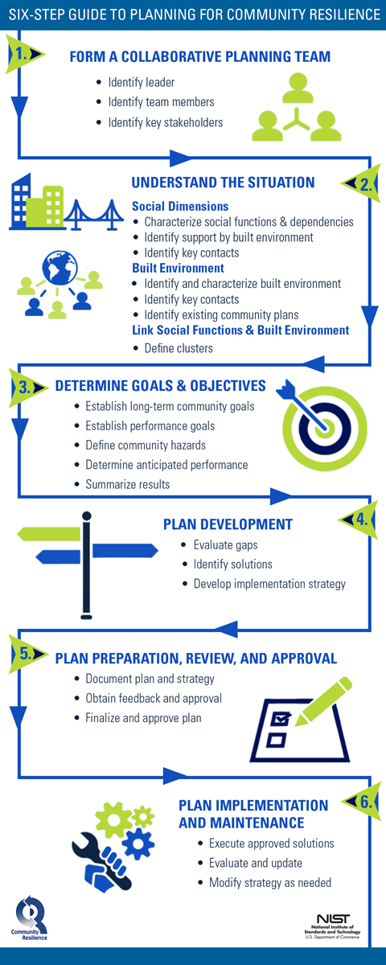
Planning Steps for Community Resilience

Slide 24
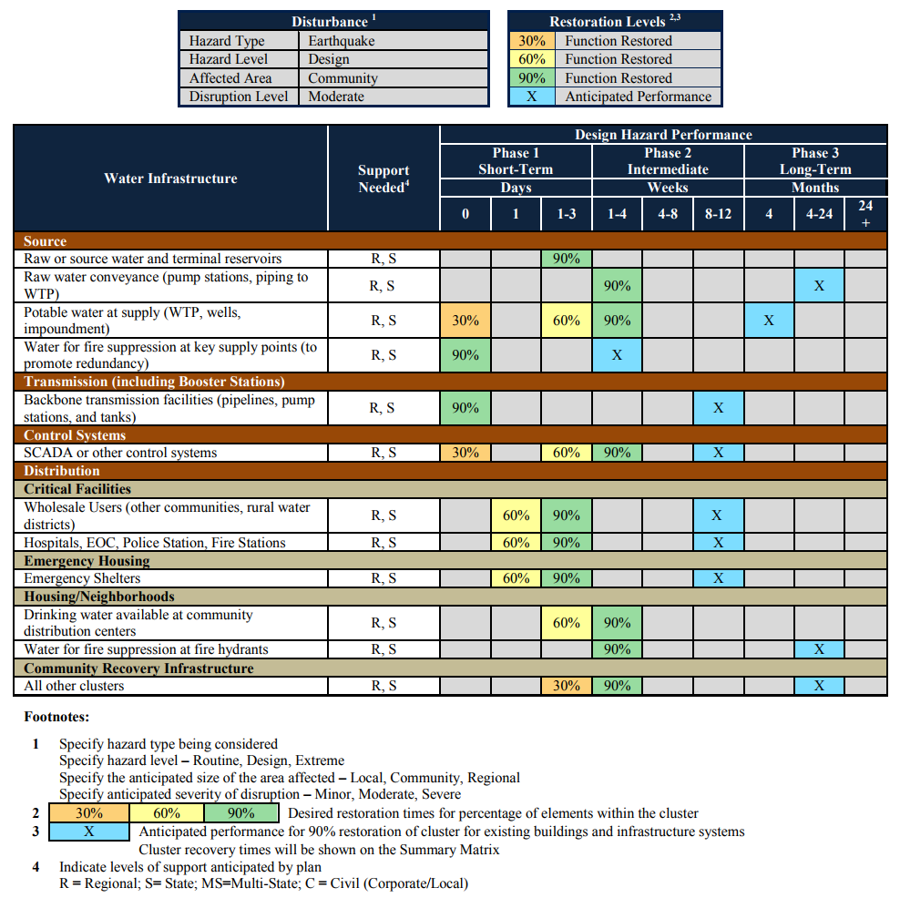
Water Performance Goal Table
Notes:
I suggest we use water as the example for the physical infrastructure and briefly describe the others. Again, delete the red box and numbers.

Slide 25
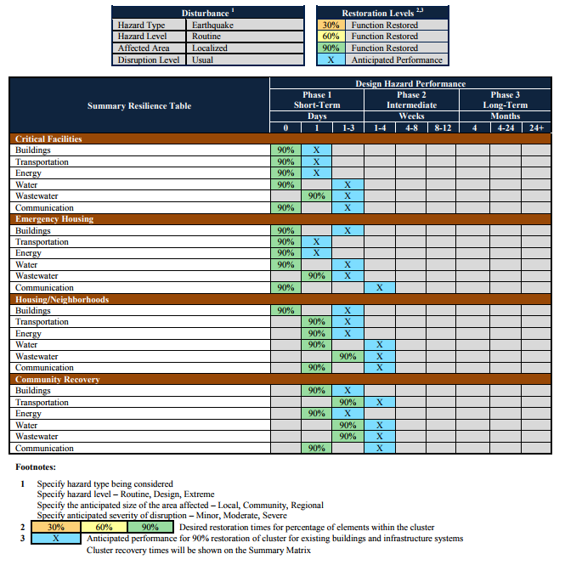
Example Summary Resilience Matrix
Notes:
Replace with Summary Table from the templates, filled out like Table 7 from GB 9. Need the header and footer information included.
This was previously hidden. Updated per text above

Slide 26
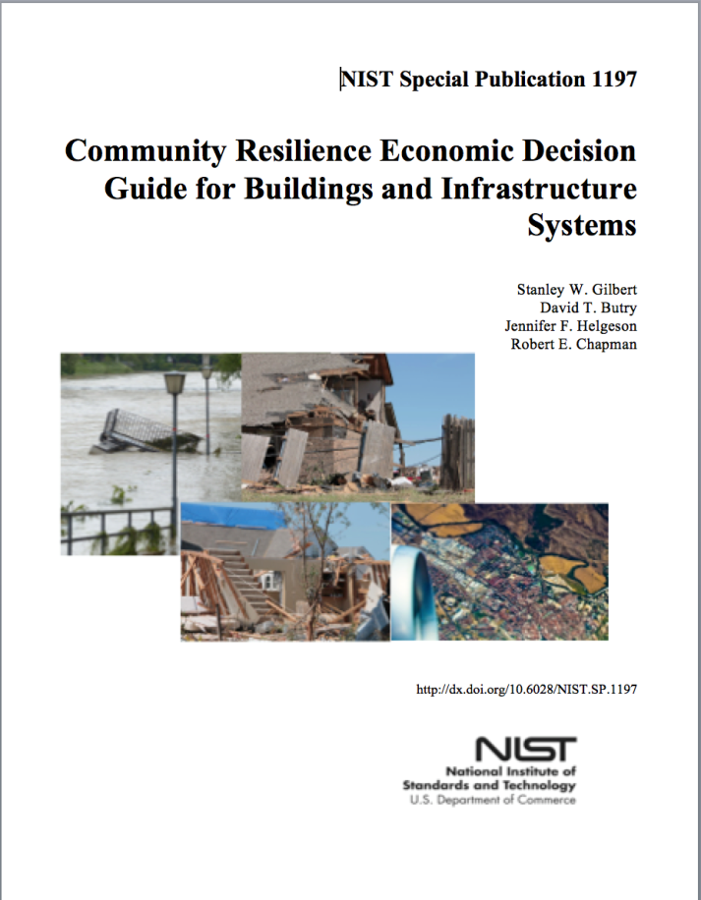
Economic Decision Guide (EDG)
Provides a standard methodology for evaluating investment decisions aimed at improving the resilience of communities
Specifically designed for use with NIST’s Community Resilience Planning Guide for Buildings and Infrastructure Systems
Provides a mechanism to evaluate the efficiency of resilience actions and to prioritize them
Frames the economic decision process
Identifies and compares resilience-related benefits & costs
Across competing alternatives
Versus the status quo (do-nothing)

Slide 27
EDGe$ Tool: Highlights
Uncertainty
hazard probability/magnitude, benefits, costs, co-benefits, co-costs
Options (for risk, frequency)
Who accrues costs and benefits?
assignment of bearers of the costs/benefits
property rights (externalities)
Graphical presentations
Co-benefits and the resilience dividend

Slide 28
NIST Contact
Website:
http://www.nist.gov/el/resilience/
Guide:
http://www.nist.gov/el/resilience/guide.cfm
Or google “NIST Resilience Planning Guide”
General E-mail: resilience@nist.gov

Slide 29
Standards for Climate Adaptation – through ISO and beyond
The ISO TC207/SC7 process is underway, along with other efforts that promise to advance the adaptation state of play …
Ira Feldman
GHGMI Adaptation Leader
Adaptation Coordinator, ISO TC207 SC7 Climate Change Standards
president & senior counsel, greentrack strategies
Founder, Climate Adaptation Scholars ™

Slide 30
Climate Adaptation and ISO
Adaptation is a new area for ISO, requiring SC7 to engage with the adaptation community to outline the adaptation landscape, framework and priorities.
Climate adaptation was included in ISO 26000 (2010).
In ISO 26000, climate adaptation was given co-equal standing with climate mitigation, which reflects the structure of the international climate dialogue.
As articulated in the ISO Directives, Annex C, development of ISO standards must be informed by understanding of the current state of play.
Any proposed ISO standards on climate adaptation must reflect the latest work in the field in order to be credible and authoritative and ultimately to be adopted and used in the marketplace.

Slide 31
SC7 Strategy Linkages
ISO
ISO TMB Climate Change Coordinating Committee
Standards Development Organizations
ISO High Level Climate Change Strategy
Guide 82 for ISO Standards Developers on Sustainability
Technical Committees
Sector Standards
TC207 Environmental Management
Climate Change Industry Standards Developers
ISO Directives Annex SP
TC207 SC7 Mitigation and Adaptation Standards
Strategy, Engagement, Communications Group
Mitigation Standards
Organization GHG Inventory Q&R
GHG Project Q&R
Product CFP Quantification
V&V of GHG Assertions
Competency and Accreditation
Adaptation Standards
High-level Framework Standard
Pre-planning (vulnerability, data) Context-specific Planning
Context-specific Implementation
Monitoring and Evaluation (M&E)
Competency and Accreditation
Standards
Users (e.g. Organizations)
Stakeholder Community
Combined Mitigation and Adaptation Standards (e.g. Project, Management)
ISO 14080 Framework Standard

Slide 32
Adaptation is very context-specific
A “one size fits all” climate adaptation standards is inappropriate because adaptation is very context-specific.
What works for private sector organizations does not necessarily apply to governmental entities or to municipalities.
Similarly, guidance at the organizational level does not apply to climate adaptation planning at the regional, national or international levels.
Additionally, different planning approaches will likely be relevant in urban areas vs. rural areas; and,
In most instances, planning in the least developed countries (LDCs) will not utilize a framework that is more applicable in developed countries.

Slide 33
Adaptation Task Force (ATF) Objectives
Describe the landscape of adaptation, resilience and related activities (supported with appropriate references)
Identify potential scopes for adaptation standards and to present such scopes within an overarching framework
Recommend which standards should be priorities in form of a “roadmap” and work programme (such recommendations should include rationale and justification)
Recommend potential ISO committees and stakeholders (e.g., UNFCCC) to liaison and engage

Slide 34
External Experts & Stakeholders (ATF)
Ira Feldman, GHGMI (ATF Leader)
Lesley Wilson, BSI (SC7 adaptation liaison to CEN)
Jordan Scantlebury, Global Cities, TC 268 (invited)
James Crask, PWC, ISO TC 292/WG2 (invited)
David Adamson, BSI, ISO TC 292/WG5 (invited)
Florin Vladu, UNFCCC
Abizou Tchinguilou, LDC Expert Group (LEG) (invited, pending LEG designee)
Quamrul Chowdury, Lead LDC negotiator
Richard Munang, UNEP Africa
Rohini Kohli, UNDP
Lola Vallejo, OECD (invited)
Dennis Bours, GEF Independent Evaluation Office
Mikko Ollikainen, Adaptation Fund
Kanta Kumari Rigaud, World Bank
Cinzia Losenno, ADB (for MDB network) and Craig Davies, EBRD
Barbara Buchner, CPI/The Global Innovation Lab for Climate Finance
Alessandra Sgobbi, European Commission, Directorate-General for Climate Action (invited)
Joel Scheraga, US EPA
Nick Xenos NRCan (Pamela Kertland, alternate)
Sven Harmeling, CARERoman Roehrle and Julia Olivier, GIZ
Anne Hammill and Jo-Ellen Parry, IISD
Yunus Arikan, ICLEI (invited, alternate to be designated)
Joyce Coffee, ND-GAIN
Marcus Moench, ISET (Kenneth MacClune, alternate)
Bjorn Bedsted, WWViews (invited))
Festus Luboyera, Uganda National Meteorological Authority
Prof. Rizaldi Boer, Bogor Agricultural University, Indonesia
Emerson Resende, Carelli Brazil

Slide 35
What are the priority sectors for implementation guidance?
Note "sectors" can be defined by economic/industry or otherwise such as community, coastal, etc.
Water infrastructure 87.3%
Food and agriculture 74.5%
Energy infrastructure 70.9%
Transportation infrastructure 70.9%
Other (please specify) 63.6%

Slide 36
Priorities for adaptation standards
Adaptation Topic | High | Medium | High + Medium
Vulnerability impact assessment | 83% | 9% | 91%
Adaptation planning – coastal regions | 64% | 30% | 93%
Adaptation planning – policy, governance, institutions | 64% | 22% | 87%
Adaptation planning – urban context “resilient cities” | 64% | 23% | 86%
Monitoring and evaluation (M&E) | 62% | 29% | 91%

Slide 37
Planning in SC7 Draft Strategic Plan
From the developed country perspective, the following topics for adaptation planning standards were prioritized:
Adaptation planning — Local/regional — “Green Infrastructure” (principles for use of green infrastructure with gray infrastructure)
Adaptation planning – Urban context – resilient cities

Slide 38
Planning in SC7 Draft Strategic Plan
From the developing country perspective, the following topics for adaptation planning standards were prioritized:
Adaptation planning — Urban/rural — “Ecosystem-based Adaptation”
Adaptation planning — Coastal regions — Managed retreat and relocation in response to sea level rise
Adaptation planning — Structural elements only — Policy/governance/institutions/stakeholders/knowledge/communication

Slide 39
SC7 process timeline
2008 SC7 Vision Report – scope includes mitigation & adaptation
2013 SC7 Adaptation AHG (no report)
May 2014 SC7 forms Adaptation AHG
Feb. 2015 SC7 ballot confirms Adaptation in SC7 scope
April 2015 Paris -- SC7 forms adaptation task force (ATF)
June-July 2015 SC7 ATF convenes international experts to develop consensus on a draft “standards roadmap”
Sep. 2015 New Delhi -- SC7 strategic planning to build on “draft strategy”, establish Task Group, and approve topics for NWIP solicitation
Nov. 2015 Communication to National Standards Bodies (NSBs)

Slide 40
SC7 process timeline
Dec. 2015 Paris -- COP-21 presentations
March 2016 NWIPs received from participating countries; presentation to UNFCCC Adaptation Committee
SC7 Core team and ATF review of NWIPs
2016 SC7 meetings in Indonesia and South Korea
NWIPs advanced to TC 207 Chairman’s Advisory Group (CAG)
Current state of play 2018:
High-level Framework Standard on Adaptation (WG9)
Adaptation Planning for Local Governments
Vulnerability Assessment
Monitoring & evaluation (M&E)
Climate finance (mitigation and adaptation)
ISO 14080 – Guidance for standards writers (mitigation and adaptation)

Slide 41
Expected Adaptation NWIPs
Adaptation Topic | Proposers
High-level Framework Standard for Adaptation (ISO 14090) | UK
Vulnerability Assessment | Germany and R. of Korea
Adaptation Planning | Japan and China, R. of Korea
Adaptation Implementation | Sector specific to be developed later, awaiting CEN activities
Adaptation Monitoring and Evaluation | Japan and China

Slide 42
Contact
Ira Feldman
ira@greentrack.com
www.greentrack.com
1-202-669-1858
SKYPE: <irafeldman>

Slide 43
Governing Infrastructure:
How Regulations, Standards, Codes and Guidelines
Are Set and Changed
J. Alfredo Gomez
US Government Accountability
Office
Stephen A. Cauffman
National Institute of Standards
and Technology
Ira Feldman
GHGMI Adaptation Leader
Adaptation Coordinator, ISO
President & Senior Counsel,
Greentrack Strategies
Founder, Climate Adaptation Scholars™

Slide 44
Thank you!
The Climate-Safe Infrastructure Webinar Series continues at least through July 2018
Upcoming webinars:
Energizing the Future: Infrastructure Opportunities & Challenges in the Energy Sector (April 18, 12pm – 1pm Pacific)
Building the Future: Infrastructure Opportunities & Challenges in the Building Sector (Date TBD, early May)
Track webinars and progress of CSIWG at: http://resources.ca.gov/climate/climate-safe-infrastructure-working-group/
Send questions or requests to Elea Becker Lowe at: Elea.Beckerlowe@resources.ca.gov

