Slide 1
Salton Sea Management Program Project Updates
October 04, 2017

Slide 2
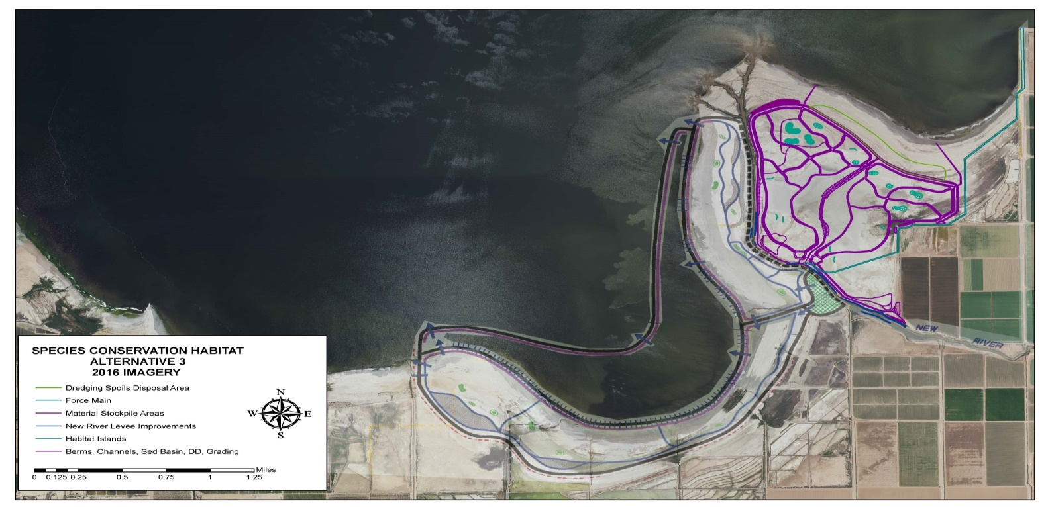
New River East & West
East: SCH NRE
100% Design package complete
Easement access pending
Developing contract with IID to clear site before bird-nesting season
West: SCH NRW
Design-Build package being prepared

Slide 3
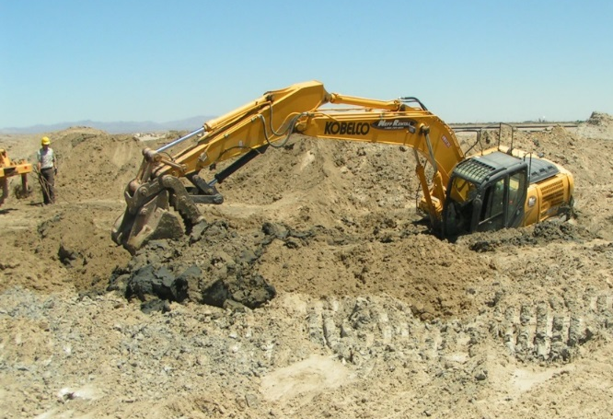
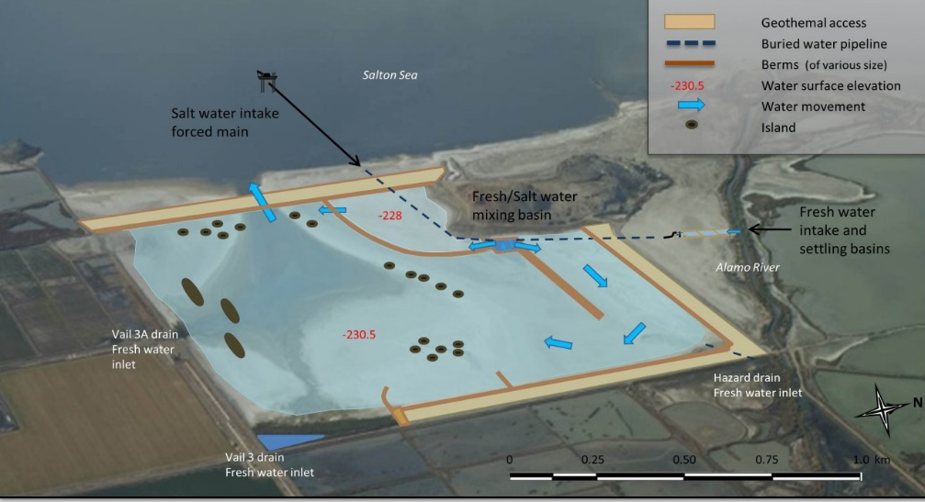
Red Hill Bay
420 acres brackish habitat
Construction started in 2016
Berm 1 under construction
All earth work to be roughed-in by end of 2017
Complications
Not easy to build on Salton Sea sediments

Slide 4
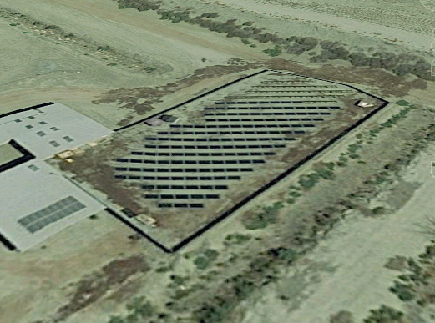
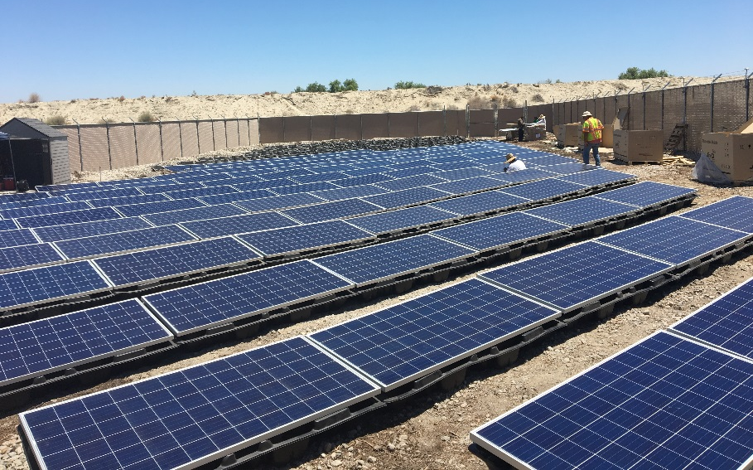
Torres Martinez Wetland Project
47 acres near Whitewater River
Solar energy array installed to power pumps
Final inspection scheduled for Friday, October 6
Ready to turn on pumps
Notes:
Construction components:
Pond areas cleared & re-contoured
Well water supply developed
Pump & piping installed
Installed solar power supply for pump
Considering proposal to expand project

